Slide 1
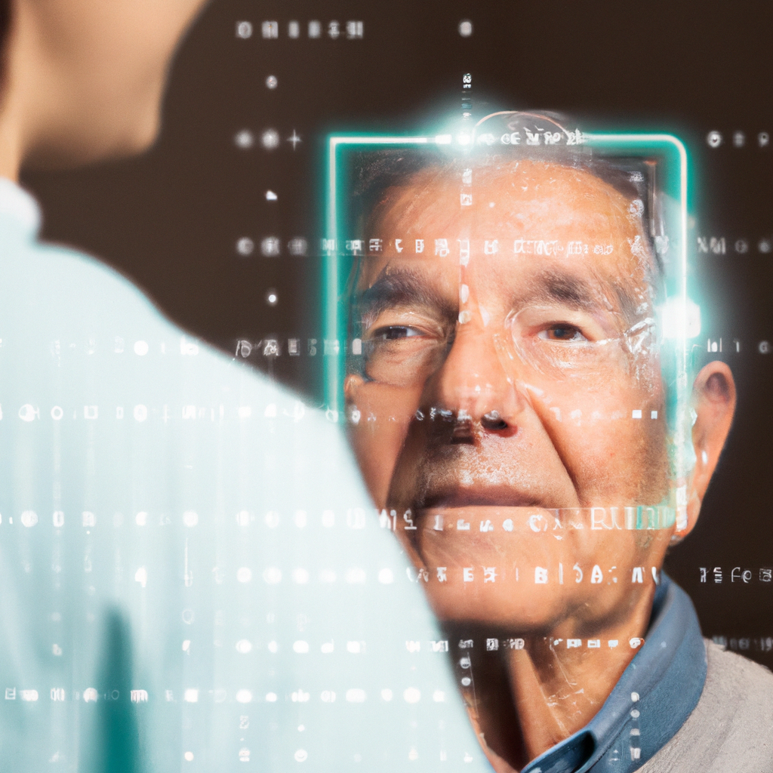


Power Of Facial Emotion Recognition Technology In Healthcare For The Elderly
Graduation Project
Computer Science Department

Slide 2





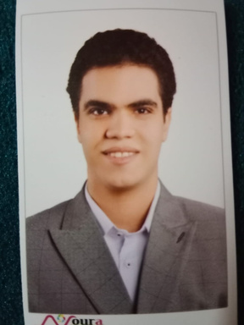
Our Team Members
Mohamed Moubarak Hussein
Team Leader
Mohamed Mahmoud Aldamrdash
Supervised By
Dr.Mohamed Haggag
Mohamed Emad Zaki Elbaroudy
Mahmoud Ahmed Salah Ali
Abdelraheem Tarek Abdelraheem
Back to Agenda

Slide 3

Introduction
Problem
Our Goal
Sloution
Pipeline
Machine Learning Model
DataBase
TimeSeries Analysis
Backend System
External APIs
Future Work
WebSite
Explanatory Video
Table of Content

Slide 4



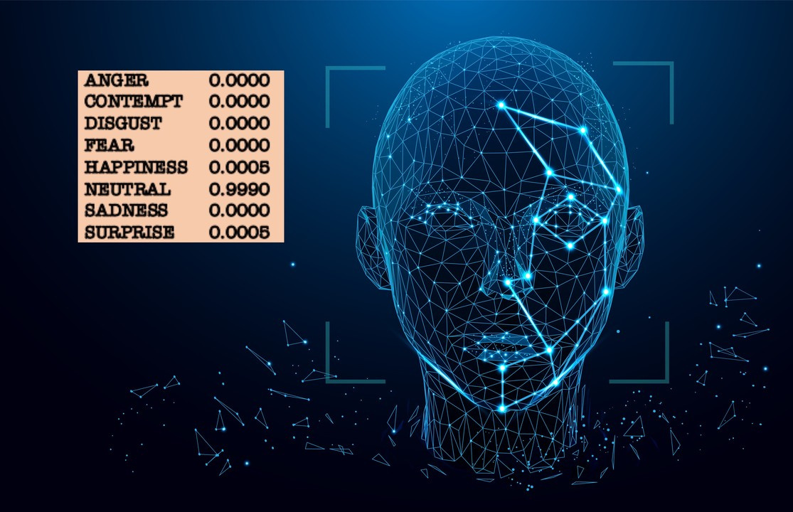
Introduction
OBJECTIVE
This project investigates the use of facial emotion recognition technology in healthcare to help elderly patients.
SIGNIFICANCE
With an aging population, there is a growing need for healthcare providers to find innovative ways to improve patient outcomes and reduce healthcare costs. Facial emotion recognition technology has the potential to improve healthcare outcomes for the elderly by enabling healthcare providers to detect and respond to emotions more effectively. By using facial emotion recognition technology in conjunction with artificial intelligence tools such as Chat GPT and music streaming services like Spotify.

Slide 5

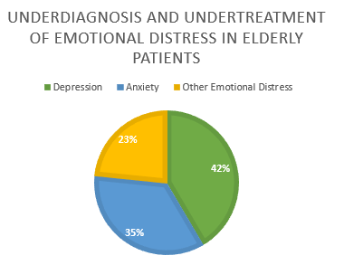
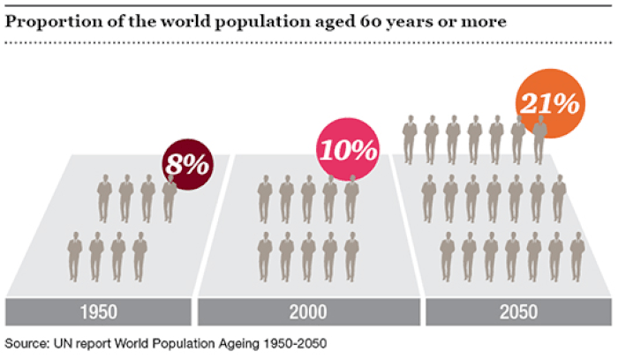
Problem

Slide 6


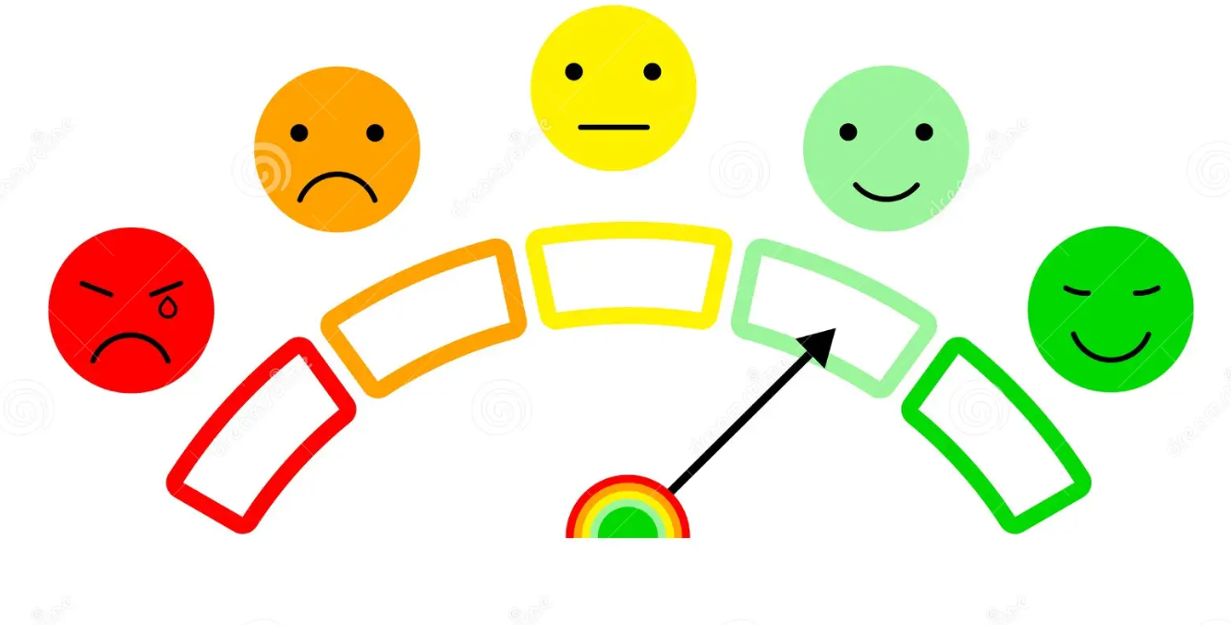




Our Goal

Slide 7


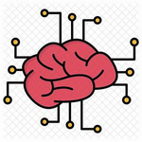





Sloution
Facial Emotion Recognition Technology
Benefits of Facial Emotion Recognition Technology
Personalized Recommendations
By using facial emotion recognition technology, healthcare providers can better understand and respond to the emotions of elderly patients, improving emotional well-being and overall health outcomes.
This technology can also be integrated into telehealth platforms, providing remote emotional assessment and treatment for elderly patients.
In healthcare, personalized recommendations can be used to improve emotional well-being, physical health, and overall quality of life.
By generating personalized recommendations based on an individual's unique needs and circumstances, healthcare providers can improve the effectiveness and efficiency of care, and ultimately improve healthcare outcomes and quality of life for patients.
This technology has the potential to revolutionize emotional assessment and treatment in healthcare, particularly for the elderly population.
By providing accurate and objective data on a patient's emotional state, facial emotion recognition technology can improve the accuracy and efficiency of emotional assessment and treatment, leading to better healthcare outcomes.

Slide 8
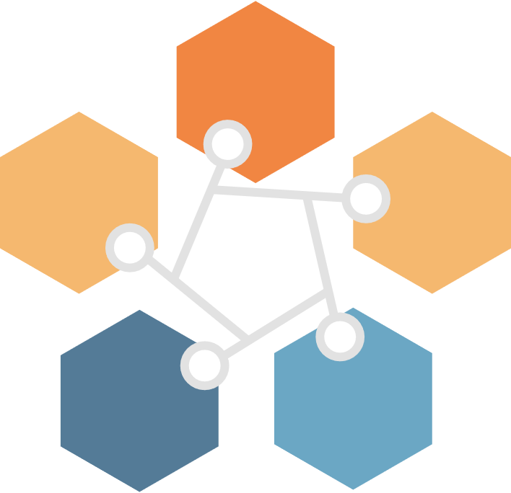

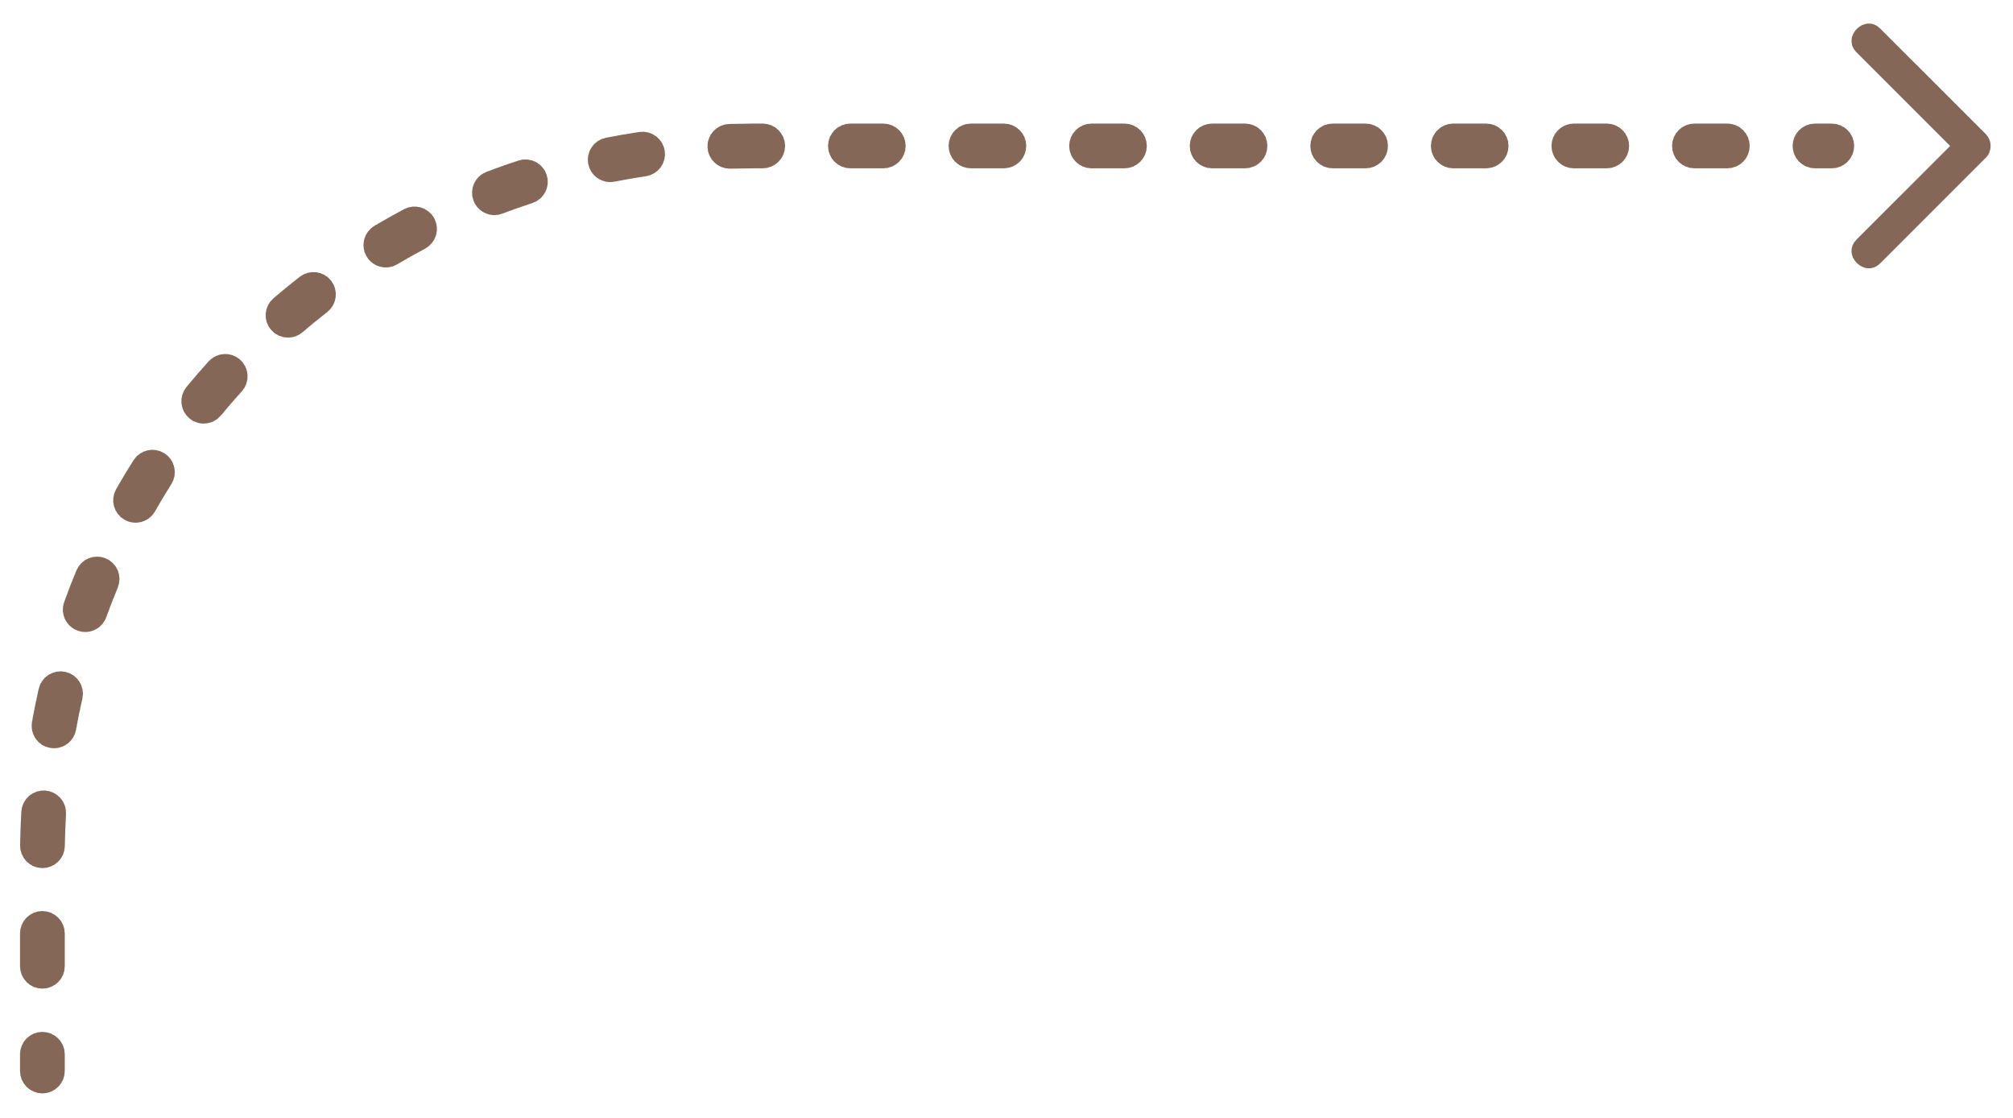




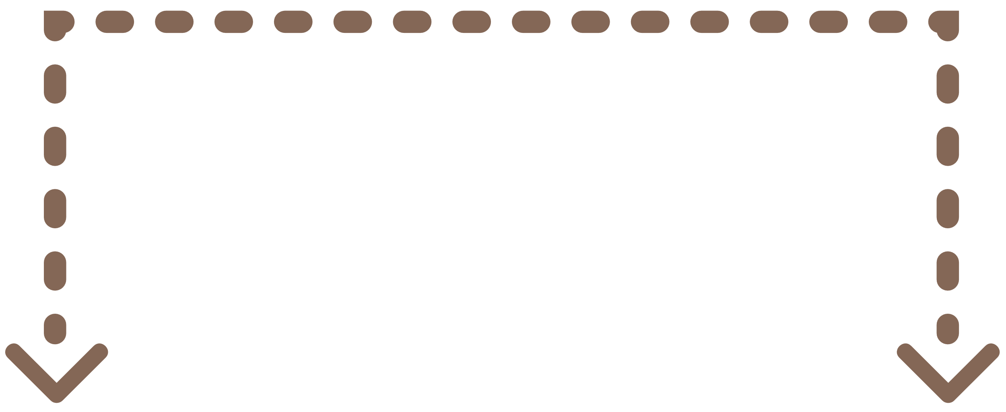
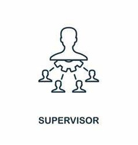

Pipeline
Machine
learning
Model
Extract
Save
TimeSeries
DataBase
Emotion
Send Data
Reports
Send Input
Camera Stream Or Video
Send Conclusion
Make
TimeSeries Analysis
API Controller And Backend Script
Send Mood
Input
External APIs
Get Response
Save Reports
Send Reports And Alerts
Send
Recommendations
Backend System for Alert and Report Management
DataBase
Send Reports
Supervisor
Client

Slide 9




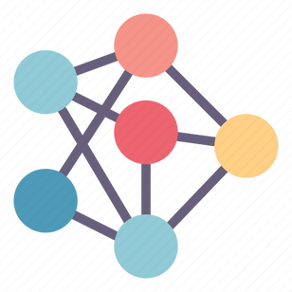

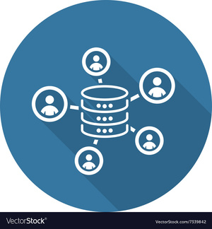




Ml Model Methodology
Ml Model Methodology
Data Preprocessing
Model Training
Data Collection
Model Selection
Model Evaluation

Slide 10
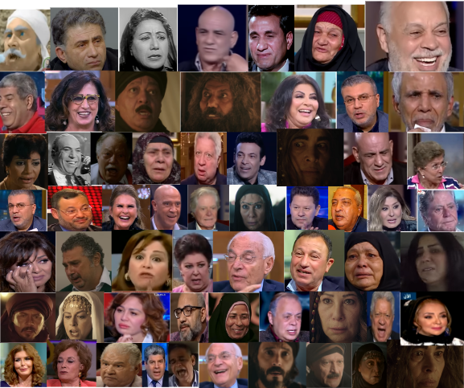


Data Collection
To create our emotion recognition dataset, we collected a lot of videos, each one 5 seconds long, based on five emotions (fear, sadness, happiness, anger and neutral). We used YouTube to collect the videos.
We downloaded Videos Using VPS
This image shows the diversity of emotions and participants in our dataset and represents the scope of our data collection efforts.

Slide 11
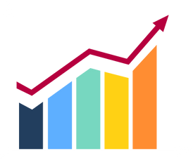
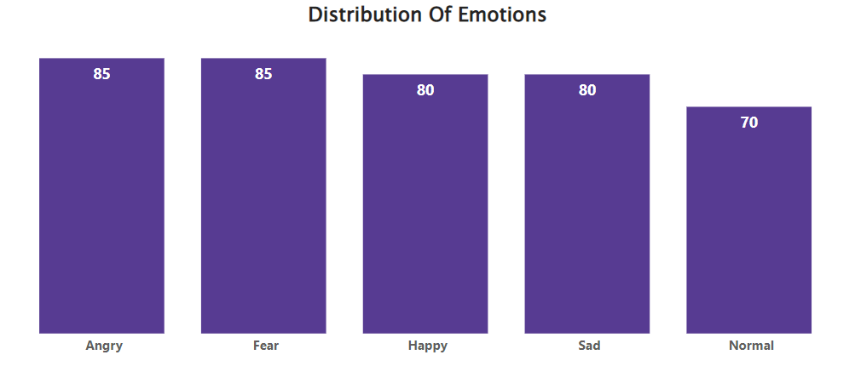
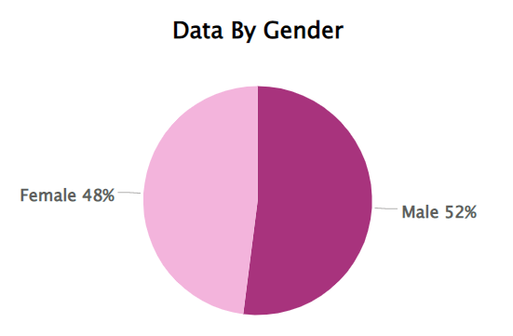
Data Collection Stats

Slide 12

Data Preprocessing
Data
Augmentation
Dimensionality Reduction
6
Feature Extraction
5
Image Normalization
Image cleaning
4
3
Cascade Classifier
2
2
1

Slide 13


Model Selection

Slide 14

Model Training
Pre-
processing
Hog Feature Extraction
LSTM Layer
Dense Layer
Training And Opimization

Slide 15

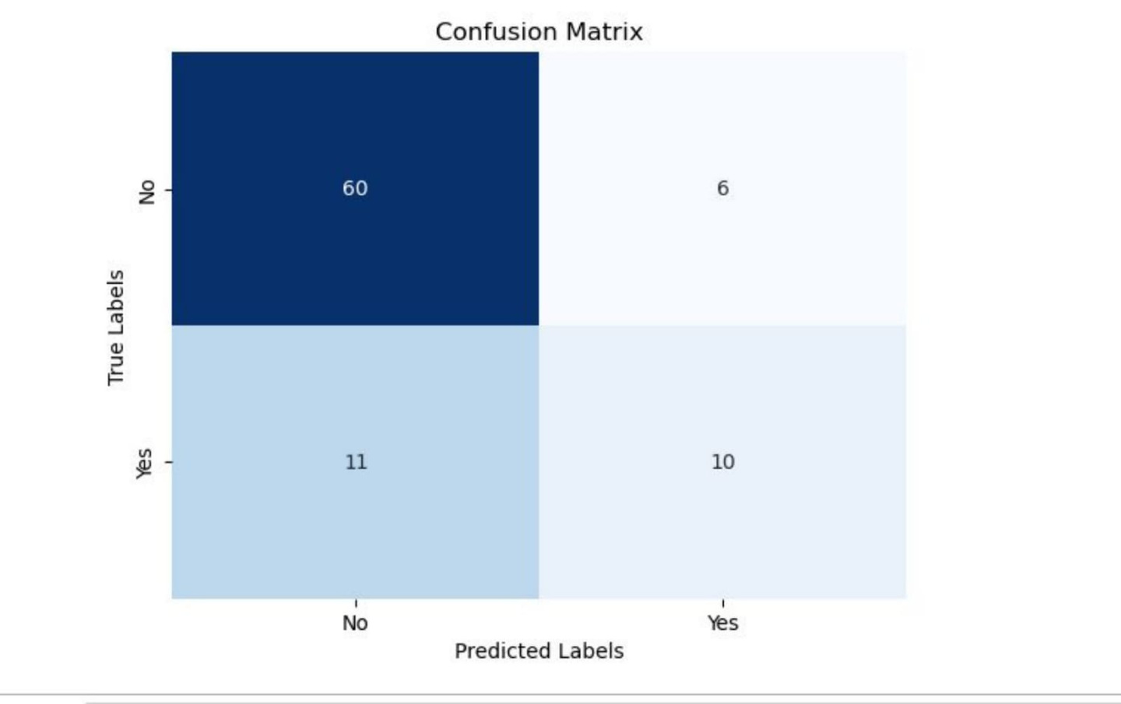
Model Evaluation

Slide 16



DataBase
EMOTION DB
USERS
ALERTS

Slide 17

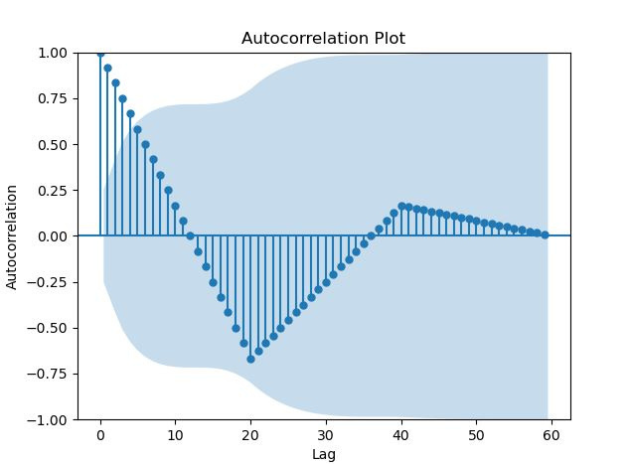
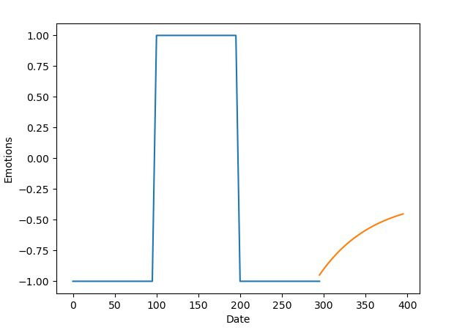
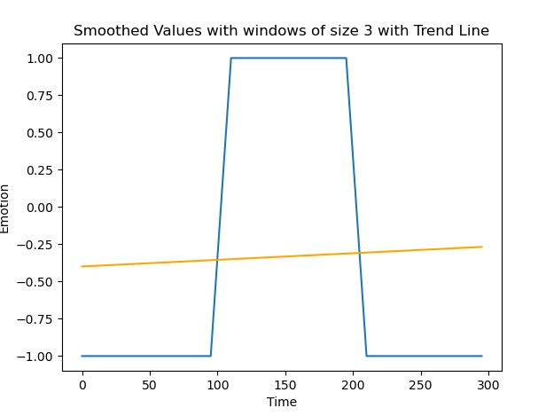
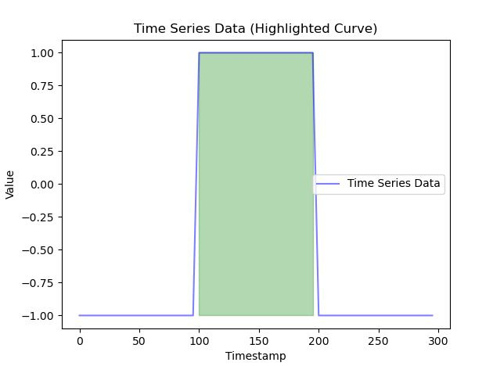
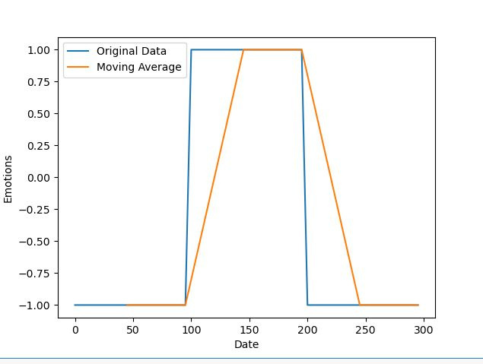
TimeSeries Analysis

Slide 18




Backend System

Slide 19







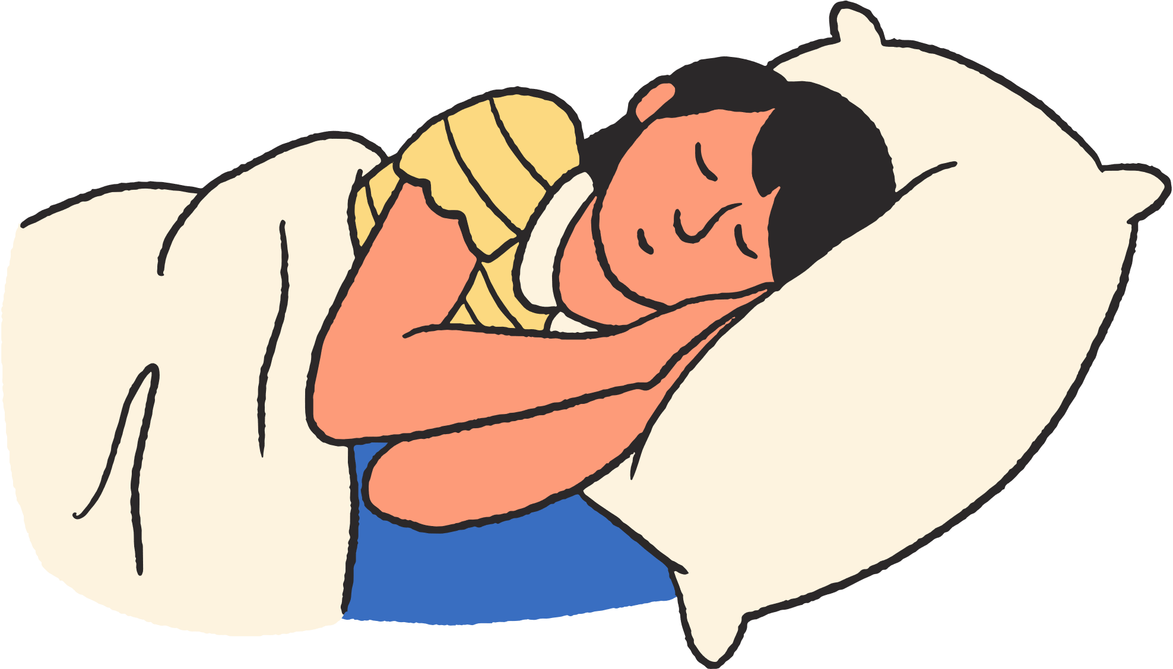






External APIs
POSITIVE
IMAGES
EXERCIESE
HABBITS
ENERGY
HAPPY
ADVICE
STORIES
MOVIES
RELAXING

Slide 20




Future Work

Slide 21

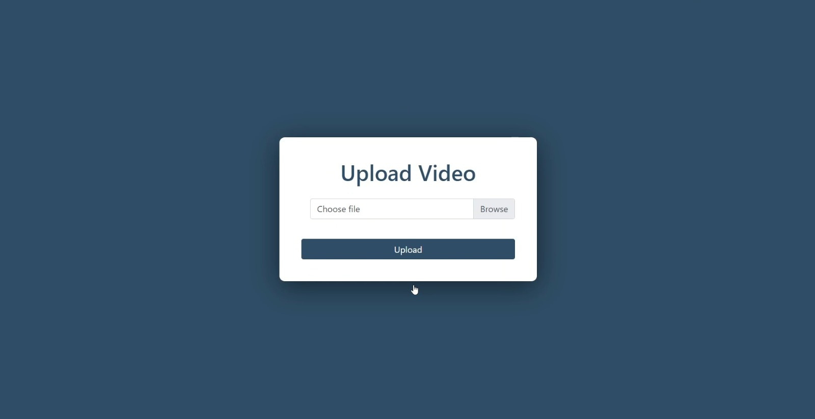
WebSite(Patient)

Slide 22
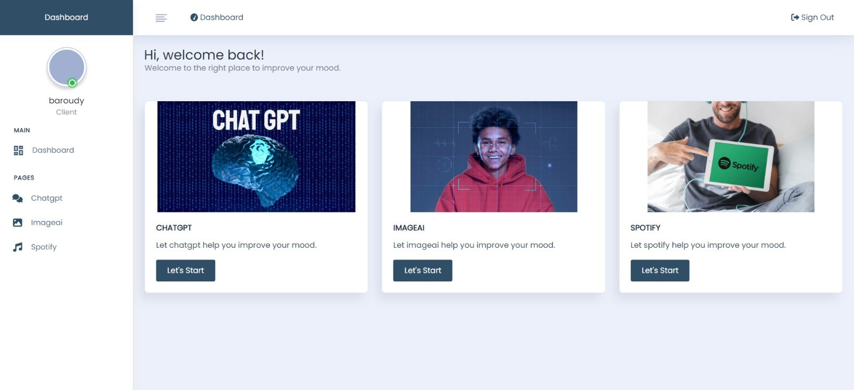
WebSite(Patient)

Slide 23

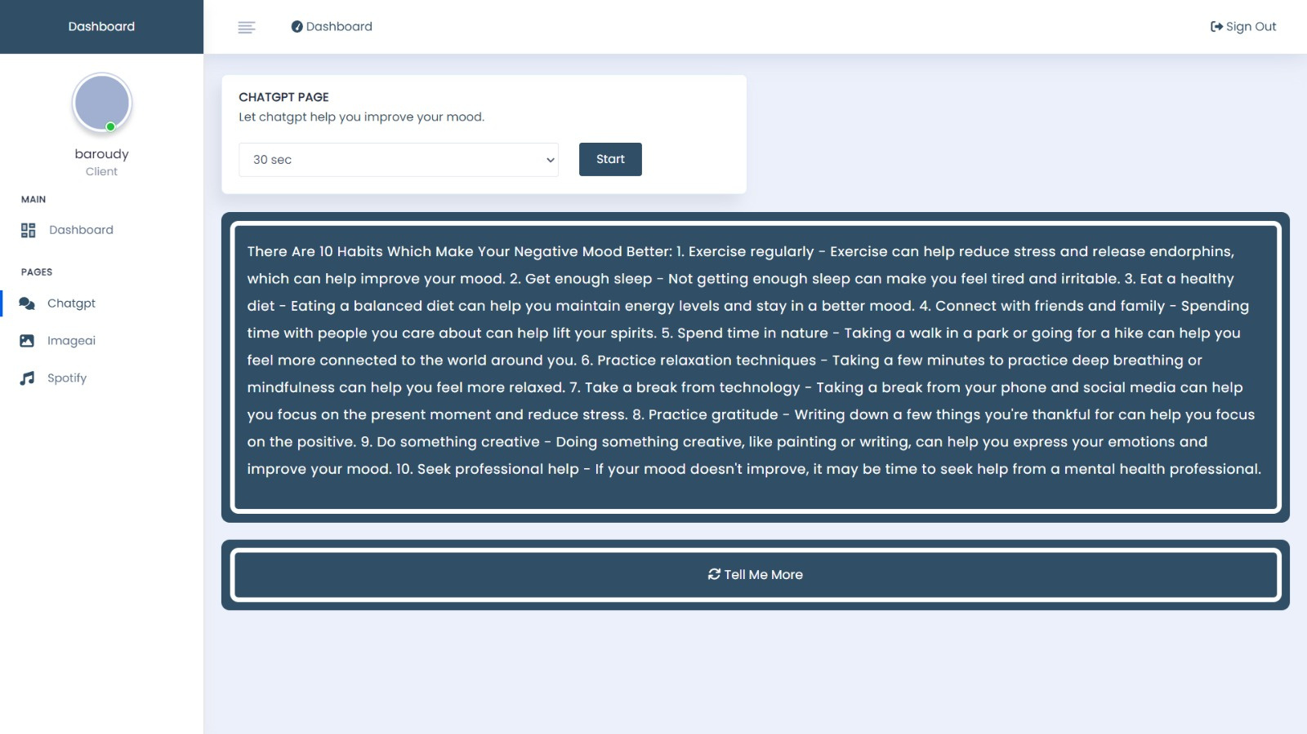
WebSite(Patient)

Slide 24

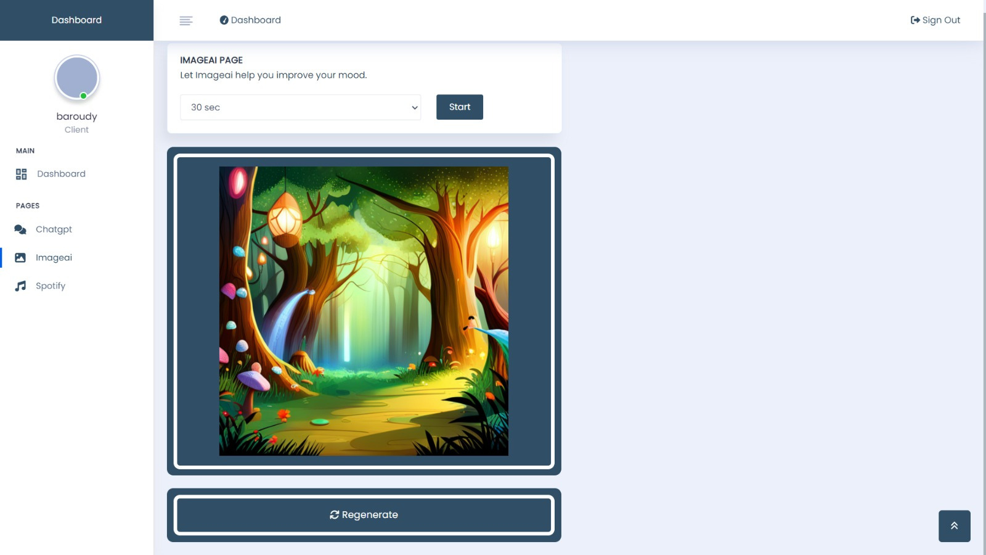
WebSite(Patient)

Slide 25
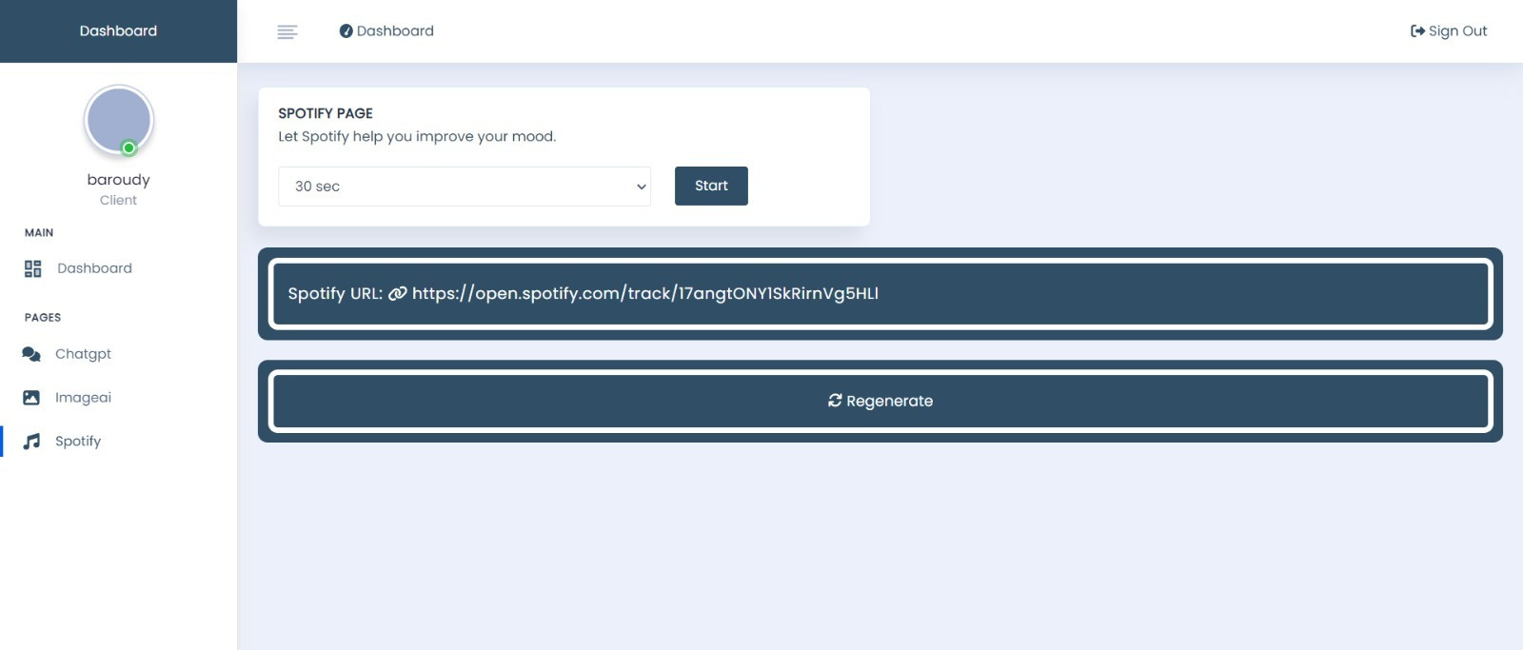
WebSite(Patient)

Slide 26
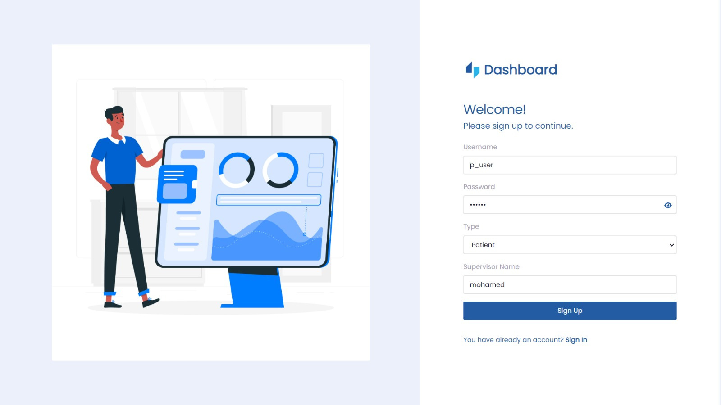
WebSite(Supervisor)

Slide 27
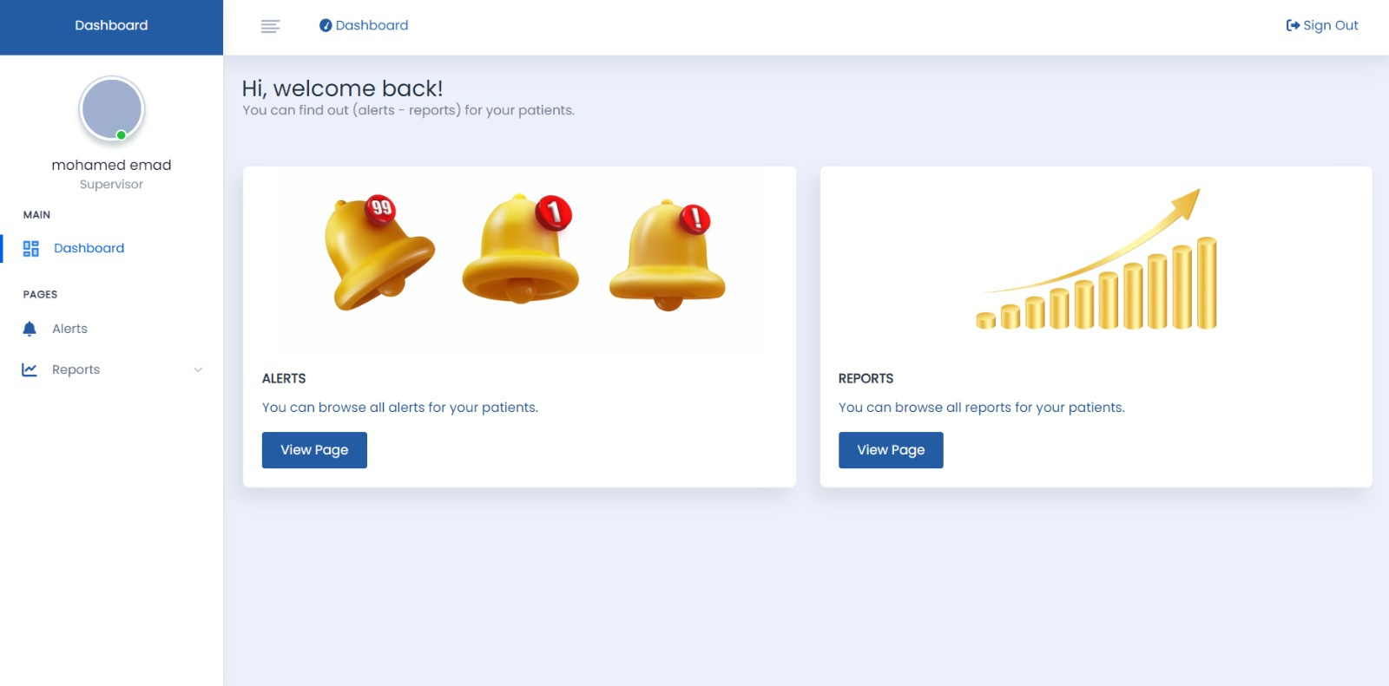
WebSite(Supervisor)

Slide 28

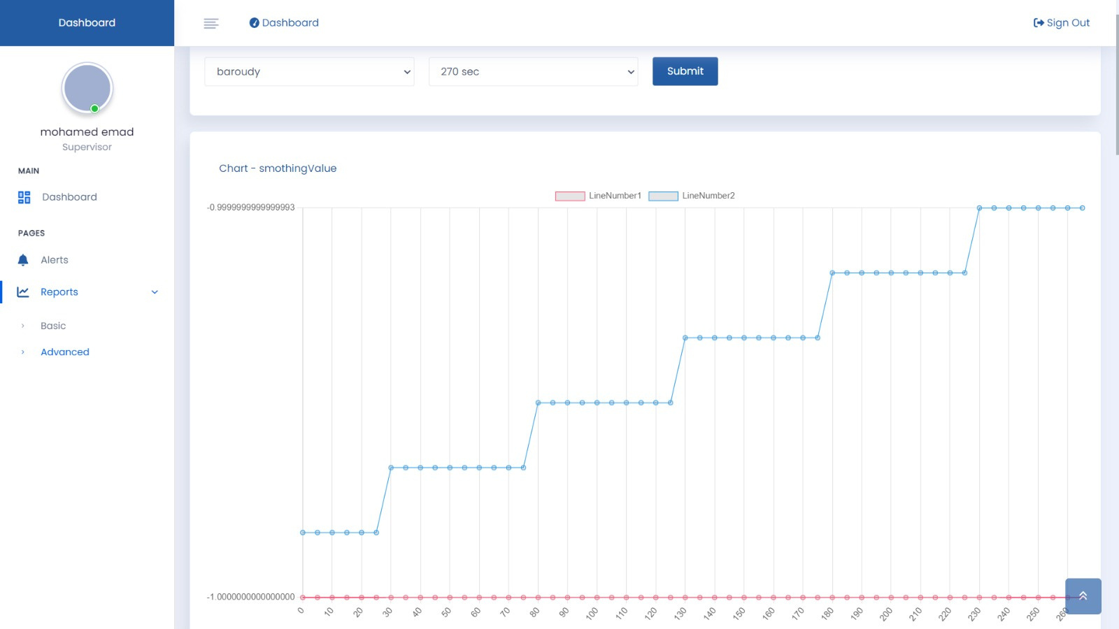
WebSite(Supervisor)

Slide 29

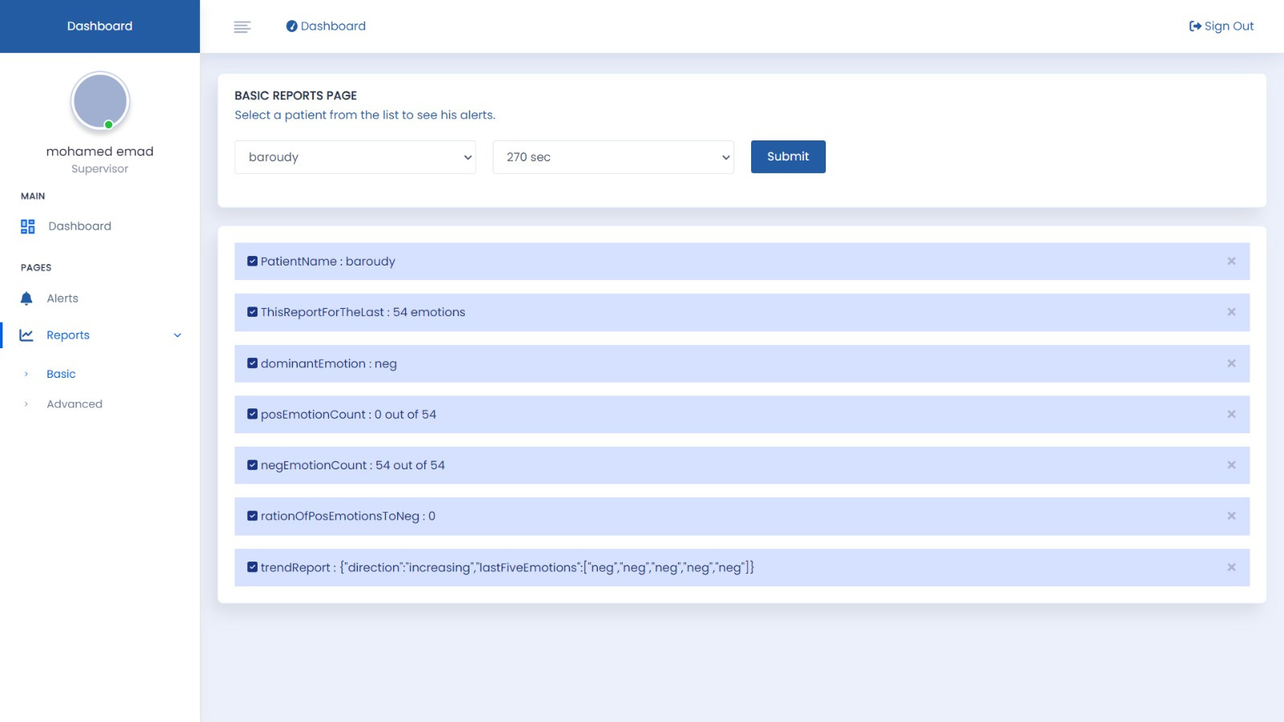
WebSite(Supervisor)

Slide 30

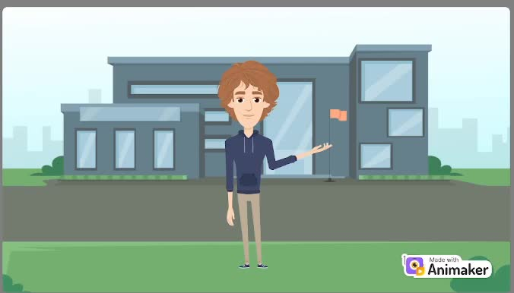
Explanatory Video

Slide 31
ANY QUESTIONS!

Slide 32


THANK YOU

